Slide 1
Delivery Route Optimization System
TEAM MEMBERS:
Pushpesh Kumar Sah
Avinash KR
Nithin J

Slide 2
PROBLEM STATEMENT:
Companies need to deliver goods efficiently to multiple locations.
Goal: Minimize fuel cost, travel time, and overall distance.
Input: Warehouse (source), delivery locations, and distances between them
Output: Optimized delivery routes and minimum network cost.
Approach:
Represent data using Graph (Adjacency Matrix)
Apply Greedy-based algorithms:
Dijkstra → Shortest path
Prim → Minimum network cost

Slide 3
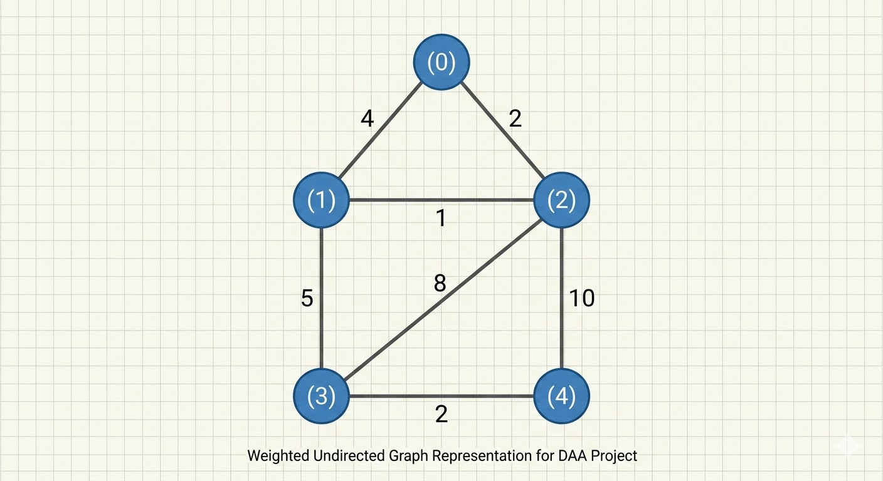
Graph Representation:
Nodes → Cities
Edges → Distance between cities

Slide 4
Greedy Algorithm:
What logic do our algorithms follow
Makes the best choice at each step
Focuses on local optimum
Does not consider future consequences
Simple and efficient approach
Used in:
Dijkstra's Algorithm
Prim's Algorithm

Slide 5
Dijkstra Algorithm:
How do we actually find the shortest delivery route?
Finds shortest path from a source node
Uses greedy approach
Selects nearest unvisited node
Updates distances step-by-step

Slide 6
Prim’s Algorithm:
How do we connect all cities with minimum total cost?
Connects all nodes with minimum cost
Uses greedy approach
Selects smallest edge at each step
Avoids cycles

Slide 7
Combined Optimization:
What if we care about both time and cost together?
Real-world problems involve multiple factors
Distance and cost both affect delivery
Combine both using weighted formula
W=α⋅D+β⋅C
W → Weight or Final Score (the result)
α → Weight factor for D (importance of D)
D → First component (e.g., Distance, Delay, or Data)
β → Weight factor for C (importance of C)
C → Second component

Slide 8
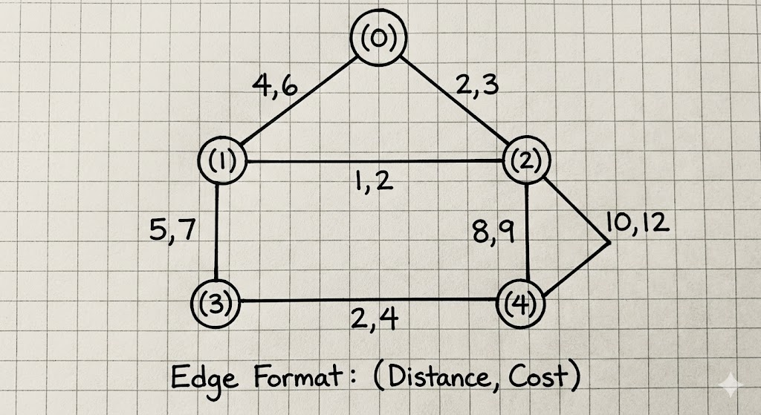

Slide 9
Result Analysis:
Dijkstra's Algorithm: → Finds fastest route from source → Example: 0 → 2 → 1 = 3
Prim's Algorithm: → Connects all cities with minimum cost → Total cost = 10
Combined Optimization: → Considers both distance and cost → Produces a balanced solution

Slide 10
Real-Life Applications:
Delivery and logistics optimization
Route planning in transportation systems
Ride-sharing and navigation systems
Network design (internet, telecom)
Supply chain and distribution management

Slide 11
Conclusion:
Graph models real-world delivery network
Greedy approach enables efficient decision-making
Dijkstra's Algorithm → shortest path
Prim's Algorithm → minimum cost
Combined approach → real-world optimization

Slide 12


